Slide 1

2021
New Kernel Training

Slide 2


Welcome
Andrea Franklin
  Volunteer Council Kernel
  councilpopcornkernel@gmail.com
Chelsey Luster
  Council Popcorn Staffer
  Chelsey.Luster@scouting.org
  popcorn@alamoareabsa.org

Slide 3
Agenda-
What’s new in 2021
Organizing your Unit’s sale
Tools and resources
Prizes and incentives
Sales Pitch
To Do list
Popcorn Empire

Slide 4
Housekeeping
Kindly hold your questions until the end, OR put them in the chat.
We will be posting links in the chat.
All documents featured tonight will be posted on our Popcorn website

Slide 5
Popcorn Empire
Andrea Franklin – Volunteer Council Kernel
Chelsey Luster – Council Popcorn Staffer
District Kernels –
  Coyote Katy Teitzel
  Fiesta Kelly Espinoza
  Mesquite Terry Ellis
  Oak Tree Greg McCulley
  Prickly Pear Pilar Colon-Martin
  River Tammy Karpowicz-Dorsey
  Roadrunner Shelley Lewis

Slide 6

What’s new? – Vendor

Slide 7
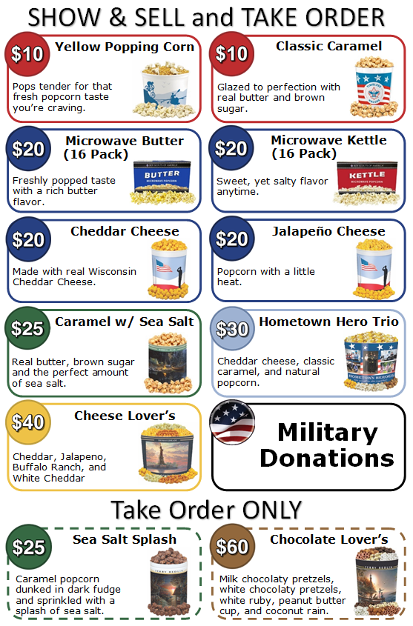
What’s new? – Products (tubs/tins)

Slide 8
What’s new? – Pantry Hours
Starting September 1st
Wednesdays: 9 AM – 1 PM
Thursdays: 3 PM – 6 PM
Fridays: by appointment ONLY (3PM – 6 PM)

Slide 9



What’s new? – Band
Use the app OR your computer
Network with other Kernels
Replaces Workplace

Slide 10
What’s new? – Commission
30% - Base Commission
33% - NO returns
32% - for selling $10k or more in S&S and TO
35% Max commission with Council Amazon.com gift cards
40% Max commission without Council Amazon.com gift cards
All online sales earn 35% commission.

Slide 11

Organizing your sale: Budget
Have an annual program planned
Identify all sources of income
Identify all expenses
Determine your cost per Scout
Set your Popcorn goal
Share your budget and goal with parents and Scouts

Slide 12
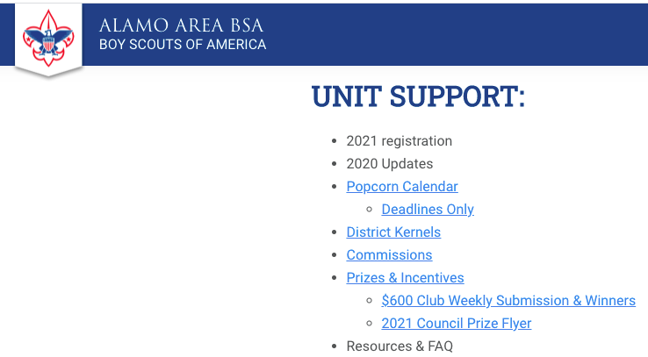

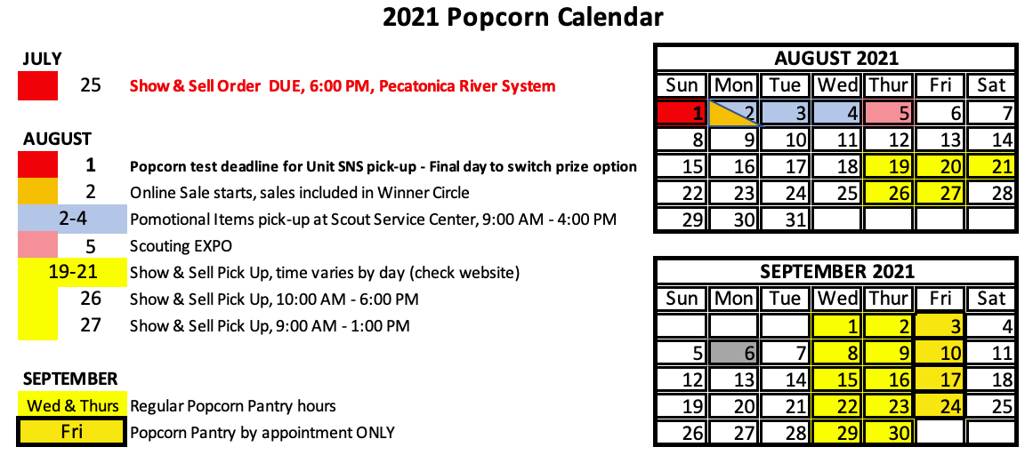
Organizing your sale: Calendar
Council deadlines
Be sure to give yourself enough time!

Slide 13

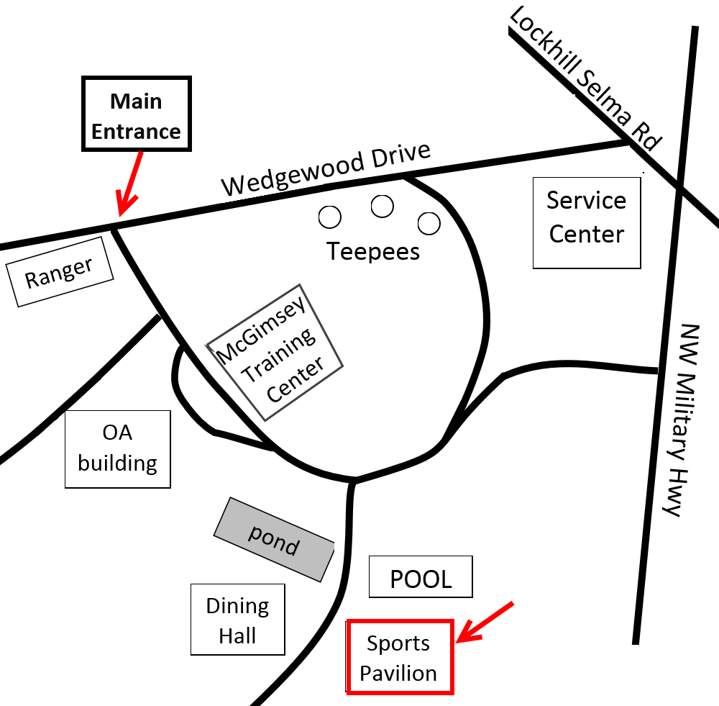
Organizing your sale: Pantry
Only order/pick up what you need
Reorders (10:59 PM Friday – 10:59 PM Sunday)
Pick up popcorn
If not listed in Scout Boss email popcorn@alamoareabsa.org
Wednesdays: 9 AM – 1 PM
Thursdays: 3 PM – 6 PM
Fridays: by appointment ONLY
(3PM – 6 PM)

Slide 14
Organizing your sale: Ways to Sell
Show & Sell
Show & Deliver (wagon sales)
Take Orders
Online (Aug. 2nd – Dec. 3rd)

Slide 15
Organizing your sale: SHARE
Put it in WRITING ✭
Show them what popcorn can pay for!
Explain your expectations
  Pick-up/return
  Sales reporting
  Phone calls/text timing
  AVOID BURNOUT!

Slide 16
Organizing your sale: Motivation
Keep Scouts/families motivated
  Shout outs
  Weekly prizes
  Competitions
  Unit prizes

Slide 17
Organizing your sale: Tracking
Document, Document, Document
Keep records for future use
Be sure to give receipts!
If you check out popcorn to Scouts – have them report their sales regularly
We’ll talk more about this ...

Slide 18

Organizing your sale: Donations
Units (Scouts) are NOT allowed to solicit
  As a rule of thumb, fundraising is when the donor gets something in return (like Popcorn or a clean car).
  Any fundraising effort must be APPROVED BEFOREHAND
    use the “Unit Money Earning Application”
    Camp Cards and Popcorn sales are already approved
Donations are OK
Put out a Donation jar
Buy excess inventory with Military donations
More donations than excess inventory?
  Add donations to your Take Order
REQUIREMENT - submit pictures of delivery to popcorn@alamoareabsa.org

Slide 19
Tools and Resources

Slide 20
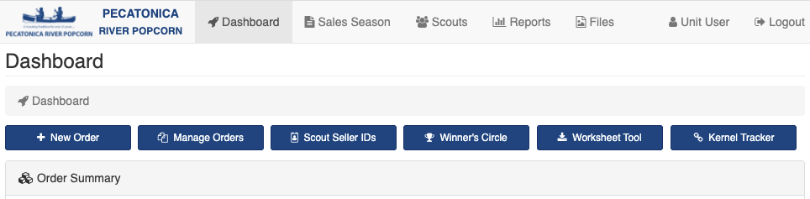
Technology – Pecatonica site
Scout Boss – order popcorn, invite Scouts, reports, Winner’s Circle entries

Slide 21
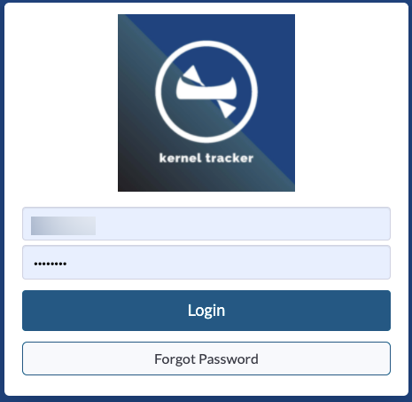
Technology – Pecatonica site
Kernel Tracker – keep track of how much popcorn you have checked out to each Scout.

Slide 22
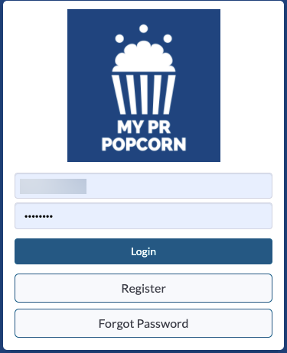
Technology – Pecatonica site
My PR Popcorn – Scout profile

Slide 23
Technology – Band
Use the app OR your computer
Network with other Kernels
Replaces Workplace

Slide 24
Trackers:
PR’s Worksheet Tool
Popcorn check out sheets
  Get signatures!!
Show & Sell sales sheets
Other trackers
Use what works for YOU!

Slide 25

Pop Swap: Unit-to-Unit transfers
ONE Unit completes the online POP SWAP form
Paper forms are for your reference
Does NOT count as a return!!!

Slide 26

The Popcorn Press: Council email
All 3 Unit Leaders will receive this periodic email
Haven’t received a Popcorn Press? Check your spam folder!
Click to see old issues:

Slide 27

Kernel’s Korner:
Pop in and ask your questions, listen for tips, or seek advise.
A virtual open forum
No training will be offered during this time.
Kernel’s Korners will be hosted periodically throughout the sale.
All dates will be posted in Band.

Slide 28
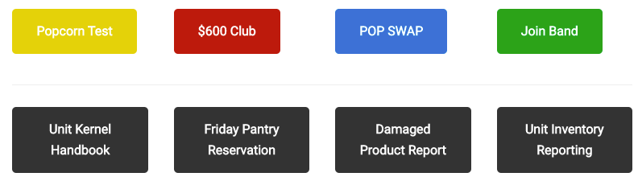
Council’s Popcorn website:
alamoareabsa.org/resources/popcorn/
Lots of Unit resources
Links to important reports etc.

Slide 29
Pecatonica River: Tech support
pops@prpopcorn.com

Slide 30
Prizes and Incentives

Slide 31
Council Program:
Units opt in/out
  5% Commission
Amazon.com gift cards

Slide 32

Council Bonus prizes:
Patch
$600 Club weekly drawing
$800 t-shirt
Top 200 ranking
Top 100 spin-and-win

Slide 33
Unit prizes:
Be creative!
NO Scout Accounts
Unit Prize ideas – pg. 29

Slide 34
Sales Pitch:
Sell Scouting!
Ask YES questions
Class A uniform!
Sample:
Hello my name is _____ and I’m with Pack/Troop _____.
My goal is to _________. May I count on your support?
Connor Franklin’s pitch tips

Slide 35
To Do list:
Make sure 2 Unit contacts are listed in Scout Boss
  Send the name and contact info for a 3rd Unit Leader to popcorn@alamoareabsa.org
Popcorn Test (2 leaders was due 8/1)
Review the suggestions in your Unit Kernel Handbook
Schedule your Unit kick-off and TRAINING
Join Band
Get to know your District Kernel!

Slide 36
Recorded Trainings
Recordings of the following trainings are available on Council’s popcorn webpage:
alamoareabsa.org/resources/popcorn/
Kernel Training – July 19th
Technology Training – July 21st
Budget Training – July 24th

Slide 37
Popcorn Empire
popcorn@alamoareabsa.org
Volunteer Council Kernel, Andrea Franklin
CouncilPopcornKernel@gmail.com
Council Popcorn Staffer, Chelsey Luster Chelsey.Luster@scouting.org

Slide 38
Popcorn Empire – District Kernels
  Coyote
  Fiesta
  Mesquite
  Oak Tree
  Prickly Pear
  River
  Roadrunner
  Katy Teitzel
  Kelly Espinoza
  Terry Ellis
  Greg McCulley
  Pilar Colon-Martin
  Tammy Karpowicz-Dorsey
  Shelley Lewis

